Slide 1
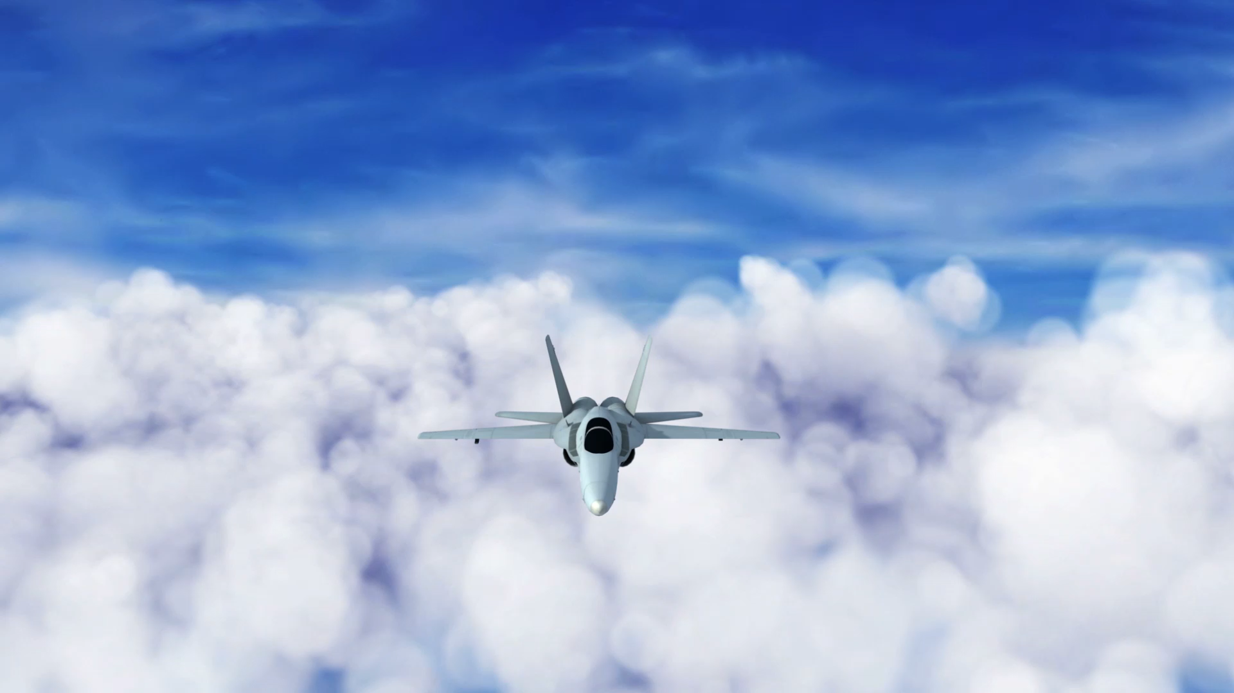
NAVIGATING AVIATION RISKS FOR BUSINESS EXPANSION
KIGEN TUWEI
30th MARCH 2025

Slide 2

OVERVIEW
In this project, we analyze aviation accident data to help a company decide which aircraft types are the safest for their new aviation business.
Using data cleaning, imputation, exploratory analysis, and visualization, we identify key risk factors associated with different aircraft models, flight purposes, weather conditions, and accident phases.
Our findings provide three actionable business recommendations to guide the company in selecting low-risk aircraft.

Slide 3

OUTLINE
Business Problems
Data and Methods
Results
Conclusions

Slide 4
BUSINESS PROBLEM
A major concern is understanding the risks associated with different aircraft types before making investment decisions.
To address this, we aim to answer the following key questions:
Which aircraft models have the lowest accident rates?
How does flight purpose affect accident risk?
What role do weather conditions play in aviation accidents?
Which phases of flight (takeoff, landing, cruise) are the riskiest?

Slide 5
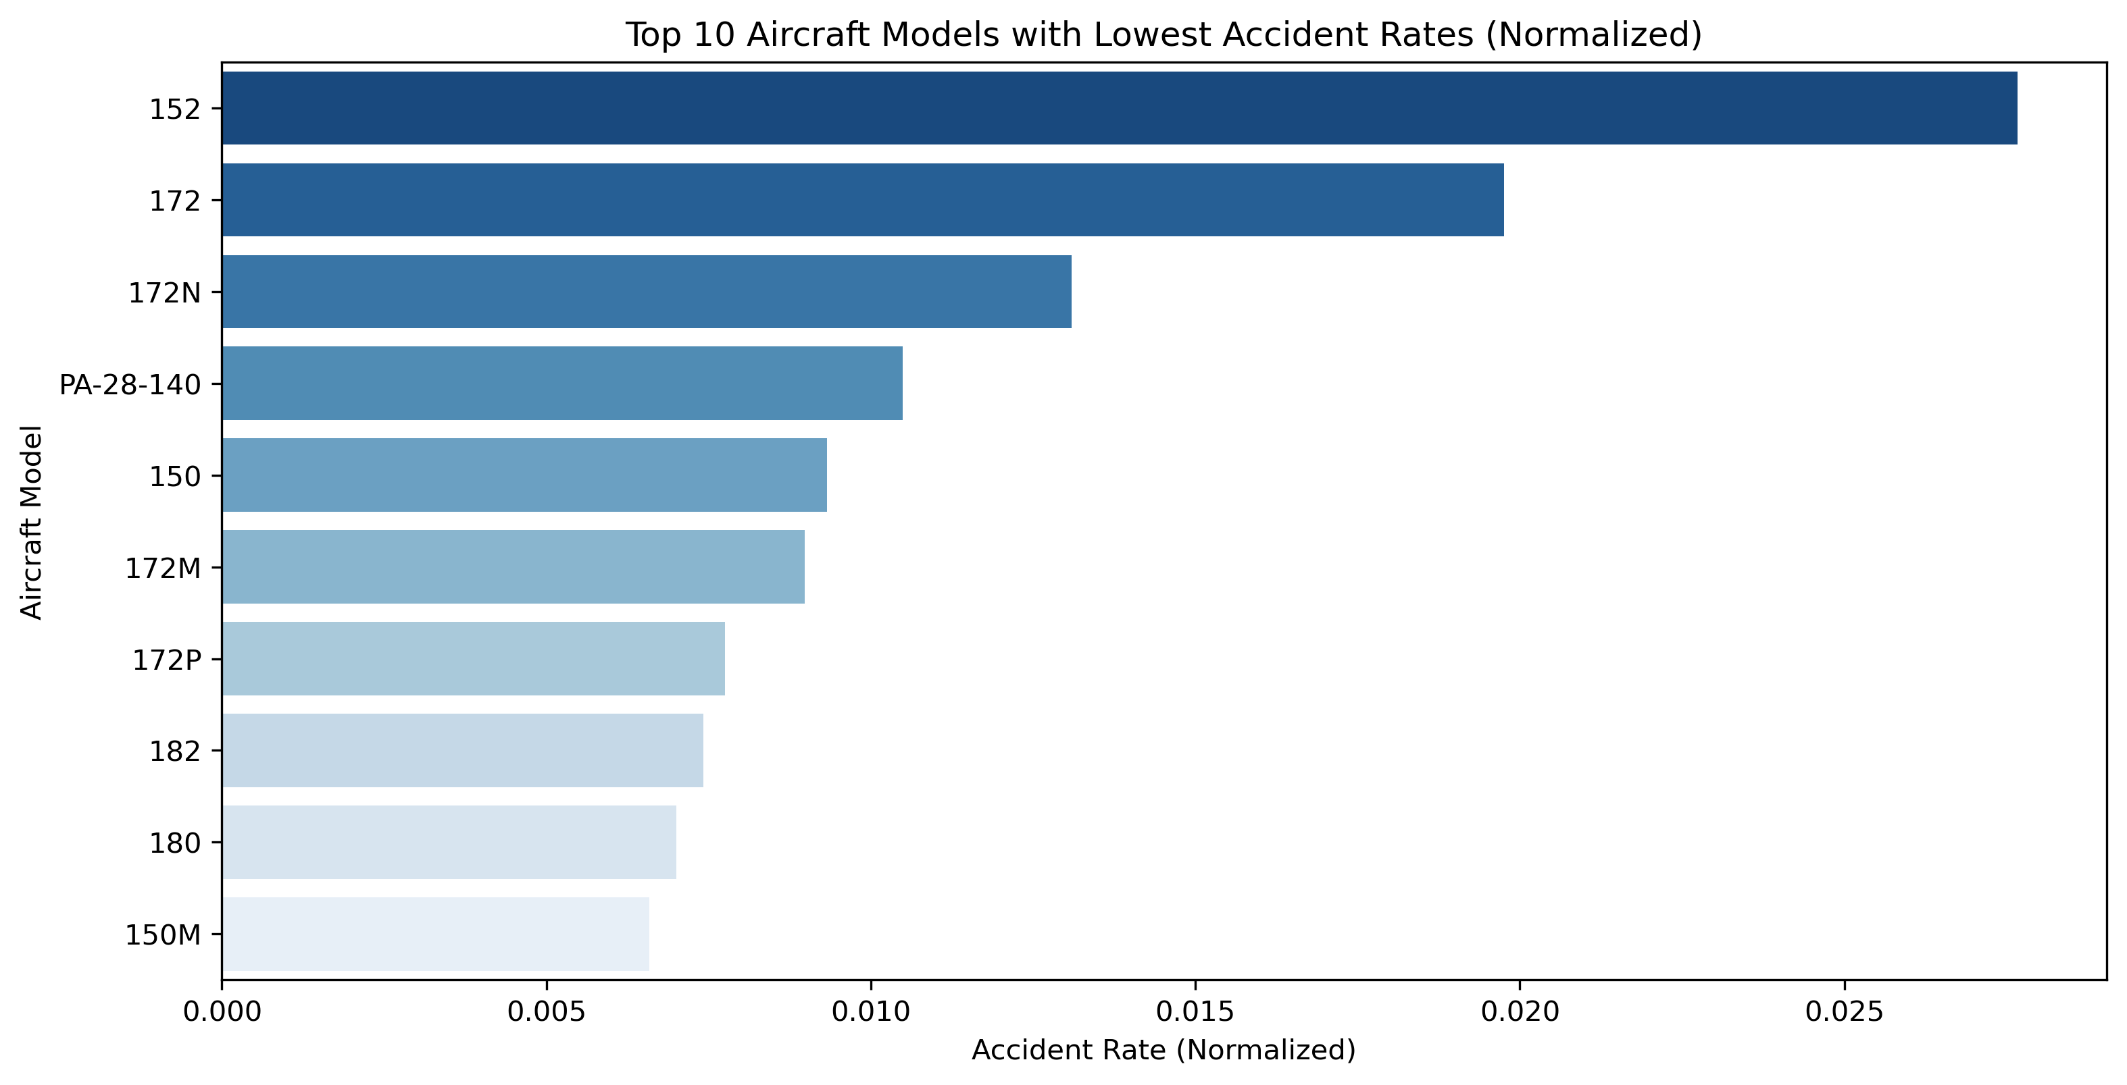
DATA AND METHODS
The models at the top of the chart have the lowest accident rates among the analyzed aircraft.These models could be considered safer choices.

Slide 6
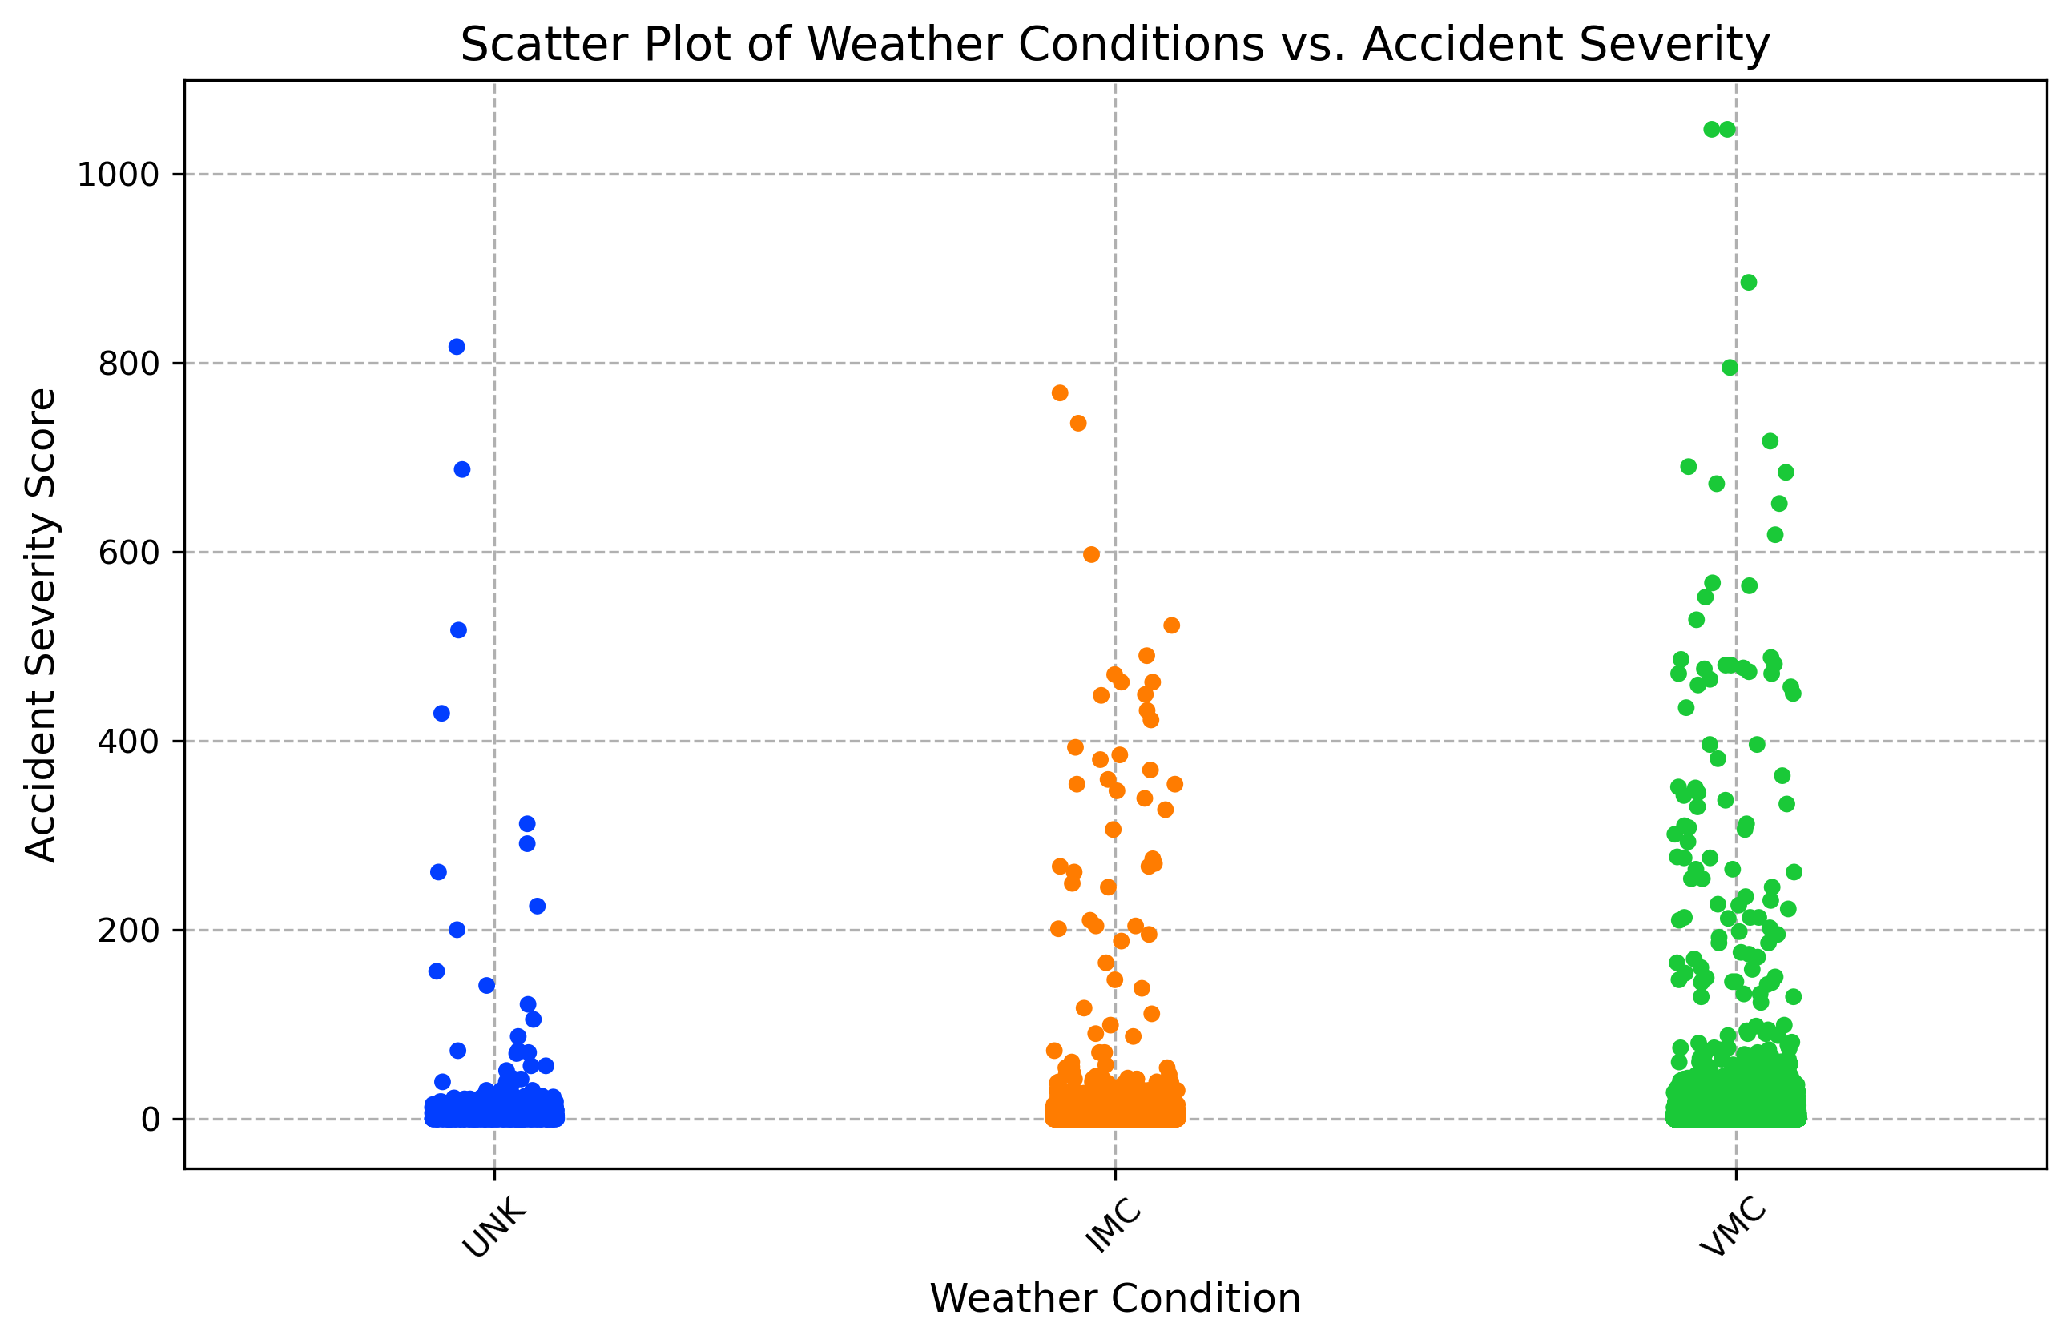
DATA AND METHODS
The green dots show a wider spread of severity values.
The blue dots are mostly clustered at the lower severity levels.
The orange dots appear spread out but not as severe as IMC.

Slide 7
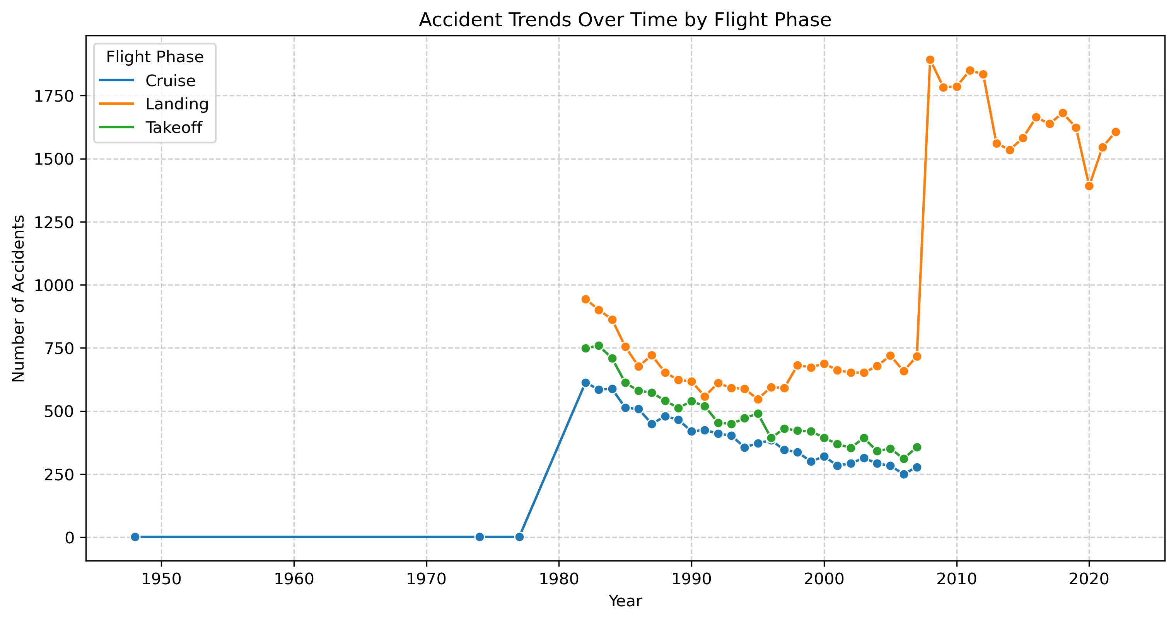
DATA AND METHODS
The orange line shows consistently higher accident counts compared to green and Cruise.
The green line follows a similar downward trend as Landing, but with a lower accident count overall.
There has been a spike in landing accidents post-2010.

Slide 8
RESULTS
Based on our earlier objectives, we’ve been able to narrow down the risk averse areas and risk prone areas.
This analysis leads to three recommendations for the Head of Aviation:
The most accident prone flight phases are takeoff and landing. I would therefore advise the Head of Aviation to invest in training and/or acquiring skilled pilot, so as to, to reduce the probability of takeoff/landing accidents. Also, I would urge him/her to invest in airport structure improvements and maintenance to reduce risk of takeoff/landing accidents.
It seems accidents in Instrument Meteorological Conditions (IMC) tend to be more severe. Therefore, I would recommend enhancing pilot training for IMC scenarios. Secondly, I would recommend improving the data collection on Unknown Conditions (UNK) herreby, increasing our ability to analyze risk.
I would recommend investing in aircraft models with the lowest accident rates, such as; 152,172,172N and PA-28-140 and avoiding those with high accident rates, such as; 150M, 180, 182, 172P.

Slide 9
CONCLUSION
The analysis of aviation accident trends across various factors; weather conditions, flight phase, accident rates, and flight purpose has provided valuable insights for improving aviation safety. Key findings include:
Weather Conditions: Accidents in IMC (Instrument Meteorological Conditions) are more severe, suggesting the need for enhanced pilot training and improved onboard safety systems.
Flight Phase Trends: A significant portion of accidents occur during takeoff and landing, highlighting the importance of procedural improvements and pilot alertness in these phases.
Accident Rates Over Time: While accident rates may have declined, fluctuations indicate ongoing risks, necessitating continued monitoring and proactive safety measures.
Flight Purpose & Severity: General aviation flights tend to have higher accident severity than commercial flights, emphasizing the need for stricter regulations and improved training for private pilots.

Slide 10
THANK YOU!
Email: kigen.tuwei@student.moringaschool.com
Github:
LinkedIn:

